Slide 1
The Impact of Large Language Models (LLMs) on MT: A European view
Kenneth Church
k.church@northeastern.edu

Slide 2
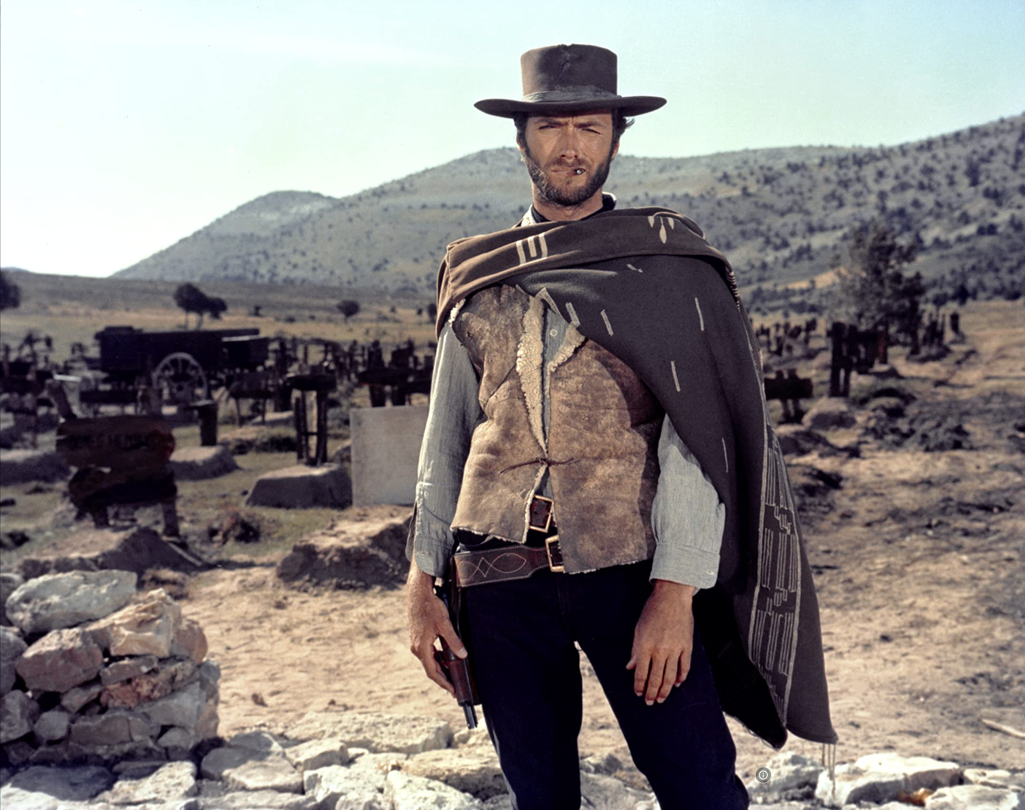
Disclaimer from an Ugly American… (The Good, the Bad and the Ugly)
This meeting reminds me of a meeting in Paris in 1995
Comparing NLP funding in America with European Community
America: funding → defense
Europe: funding → community
At that time, there were concerns about web
Would WWW be bad for French?
In retrospect,
Web has been good for languages, big and small
In general,
Technology → Change (for better and for worse)
Tech has upsides and downsides (and worse)

Slide 3

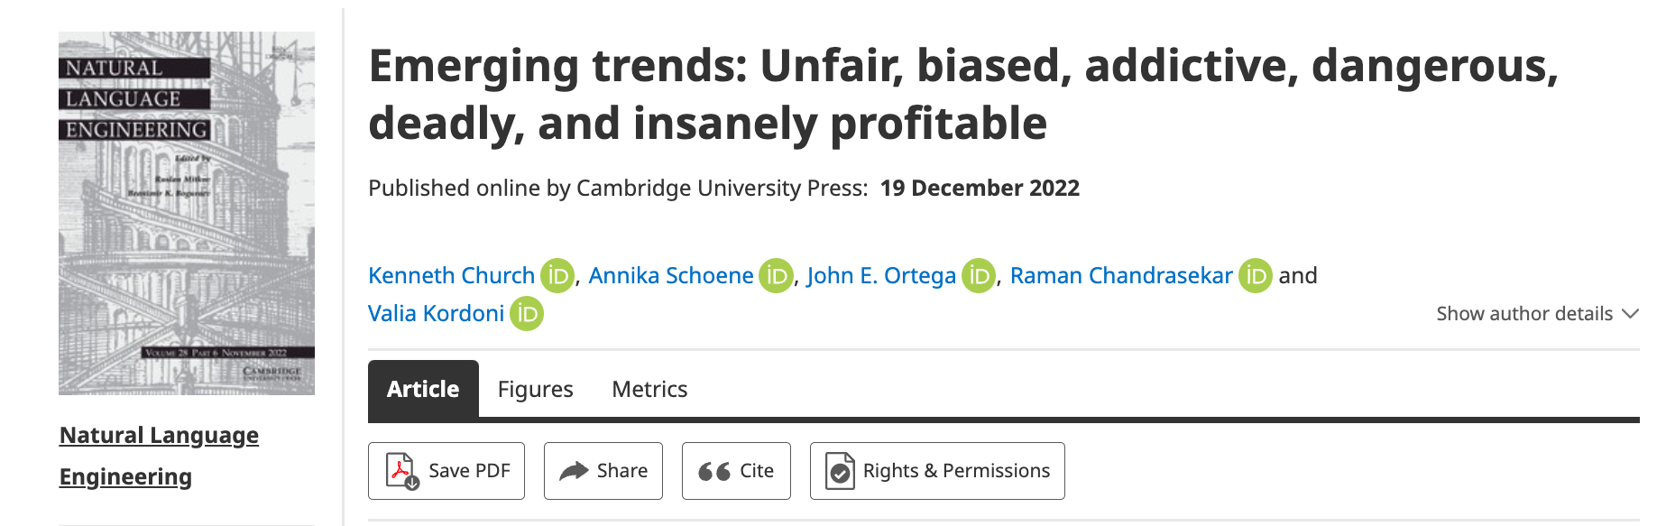
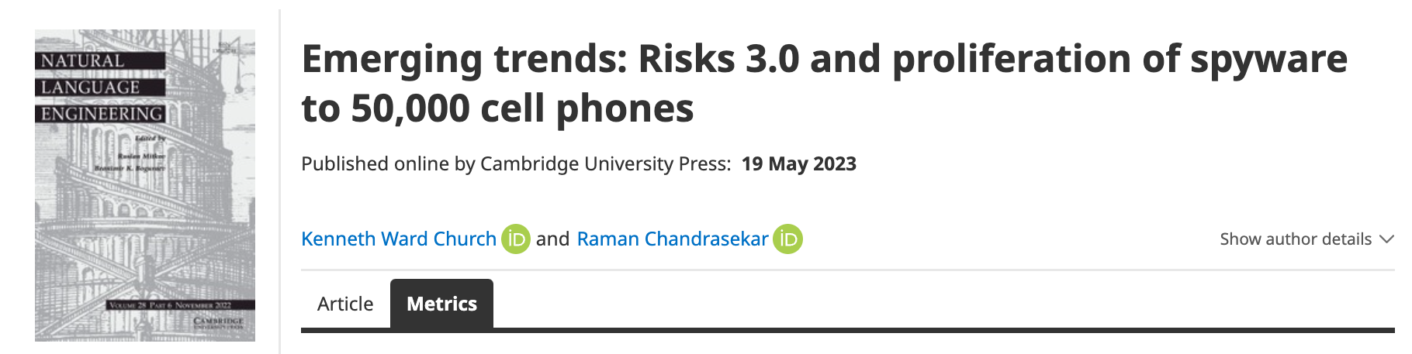
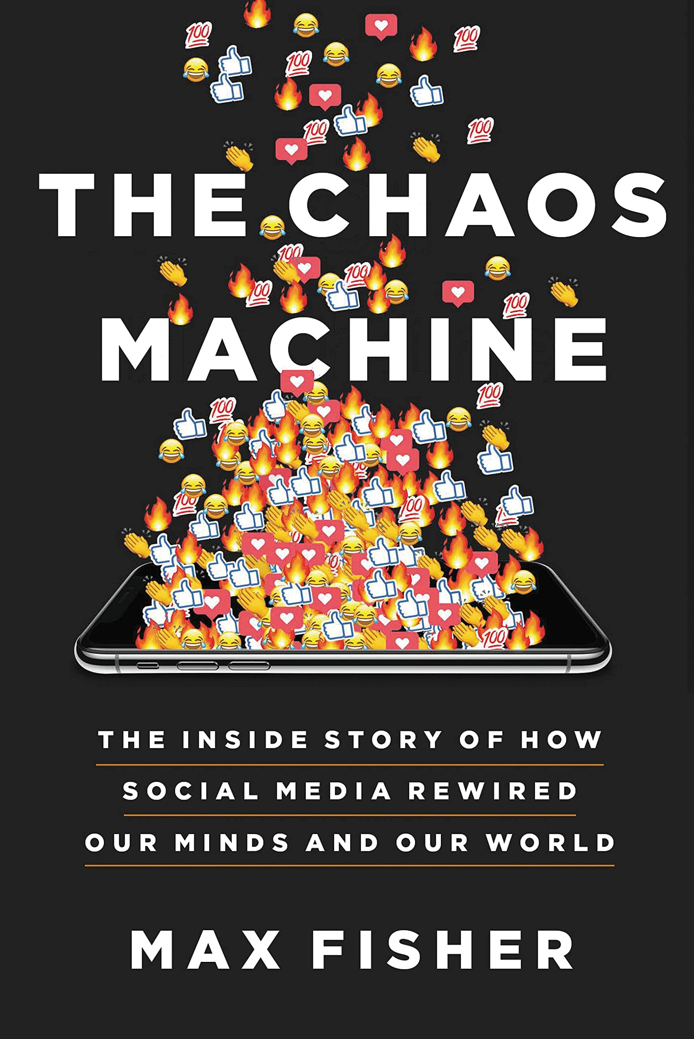


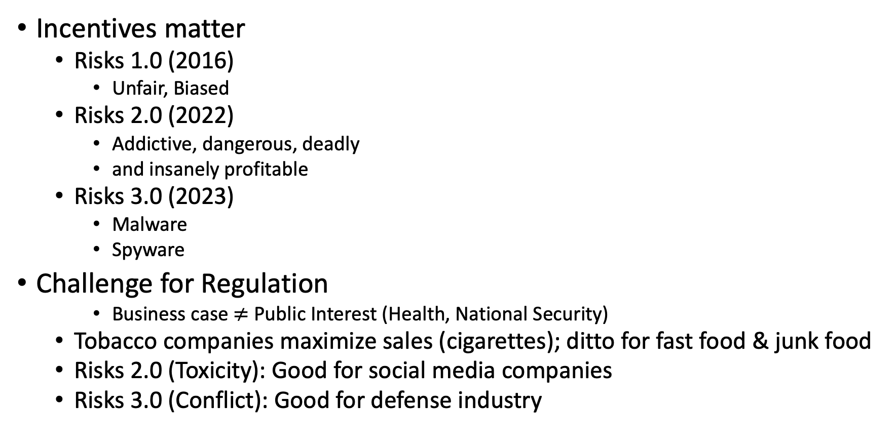
Ugly: Responsible AI
Incentives matter
Risks 1.0 (2016)
Unfair, Biased
Risks 2.0 (2022)
Addictive, dangerous, deadly
and insanely profitable
Risks 3.0 (2023)
Malware
Spyware
Challenge for Regulation
Business case $≠$ Public Interest (Health, National Security)
Tobacco companies maximize sales (cigarettes); ditto for fast food & junk food
Risks 2.0 (Toxicity): Good for social media companies
Risks 3.0 (Conflict): Good for defense industry

Slide 4
Positive Opportunities for Machine Translation
Technology is good enough
that I could work for Baidu
even though my Chinese
is worse than my French
Functionality
Inputs: phones
camera, microphone, scanner
documents (html, pdf, ppt, xls)
Outputs:
documents, microphone, etc.
low latency, multimodal
Widely deployed (in China)
Hotels, taxis, coffee shops, etc.
Anyone with a phone (everyone)
Knows how to use this stuff
Metrics suggest
Technology is better than people
But I am more productive
with a human interpreter
Metrics: BLEU & latency
Human interpreters tell me
what I need to know
when I need to know it
Trust:
``ecology’’ vs ``eco-system’’
``corruption’’

Slide 5
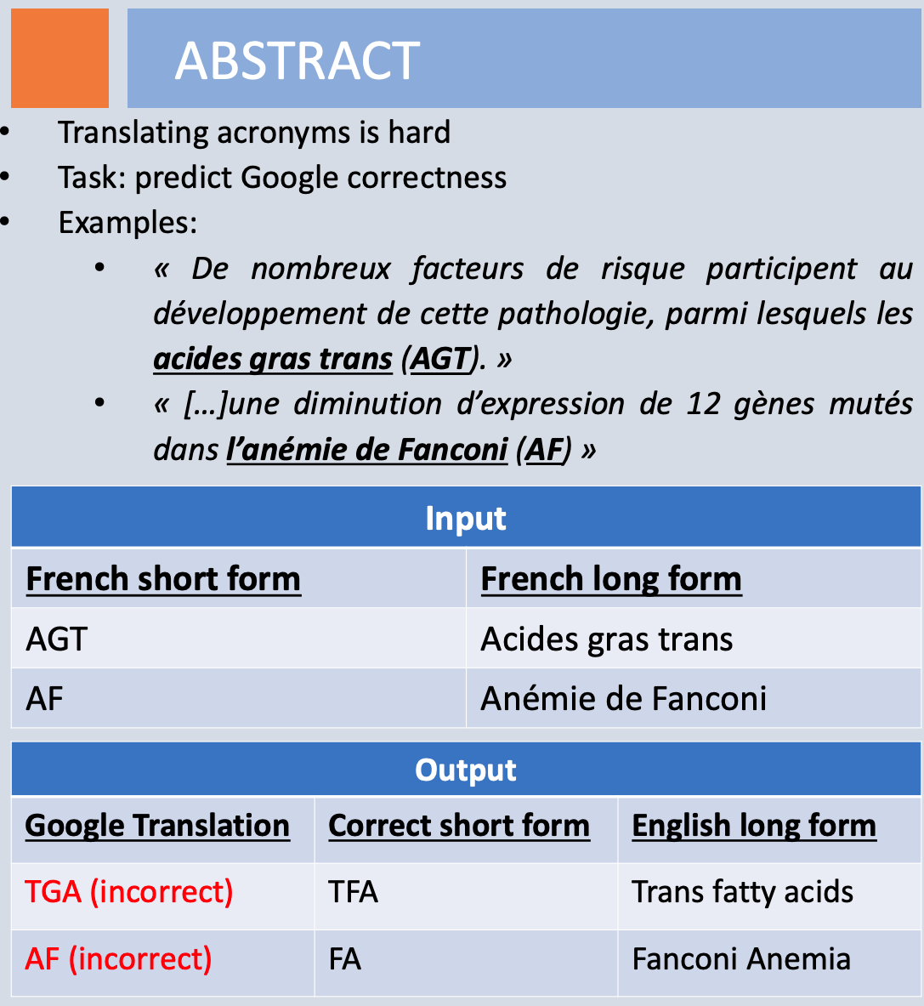
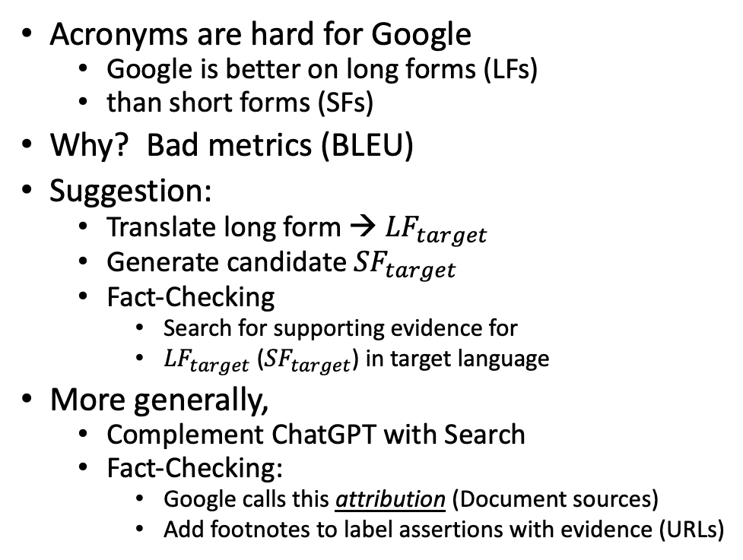
Mismatch Between Translators & Engineers: Technical Terminology
Acronyms are hard for Google
Google is better on long forms (LFs)
than short forms (SFs)
Why? Bad metrics (BLEU)
Suggestion:
Translate long form → ${LF}_{target}$
Generate candidate ${SF}_{target}$
Fact-Checking
Search for supporting evidence for
${LF}_{target}$ (${SF}_{target}$) in target language
More generally,
Complement ChatGPT with Search
Fact-Checking:
Google calls this attribution (Document sources)
Add footnotes to label assertions with evidence (URLs)

